Slide 1


Python

Slide 2
Heritage and Philosophy

Slide 3

Guido van Rossum
Python was invented in the late 1980s by Guido van Rossum at Centrum Wiskunde & Informatica (CWI) in the Netherlands as a successor to the ABC programming language
Python’s core philosophy is summarised in “The Zen of Python” which is a collection of 19 "guiding principles" for writing computer programs that influence the design of the Python programming language. This helps promote clean and simple code.
Including principles such as “Beautiful is better than ugly”, “Simple is better than complex”, “Flat is better that nested”

Slide 4
Development Platforms

Slide 5
Development Platforms
Python can be used across various platforms, ranging from web development using frameworks like Django and Flask, to data analysis, AI , and scientific computing. It thrives in both scripting and developing full-fledge applications. Popular development environments include PyCharm, Visual Studio Code and IDLE.
JavaScript is primarily used for web development. It is initially a front-end language; It now supports server-side development thanks to Node.js. Meaning it can be used to build full-stack application.
Python: Versatile, used for web development, data analysis, AI, and more
Popular IDEs include PyCharm, Visual Studio Code, and IDLE
Can be run directly from the command line or in interactive shells
JavaScript: Primarily used for web development (client-side and server-side with Node.js)
Often developed in browsers' developer tools or text editors
Typically runs in web browsers or Node.js environment

Slide 6
Characteristics, Strengths and Weaknesses

Slide 7
Python
Strength:
Easy to read and write due to its clean syntax
Extensive standard library and third-party packages
Strong support for scientific computing and data analysis
Weakness:
Slower execution speed compared to compiled languages
Global Interpreter Lock (GIL) can limit multi-threading performance
Python has an easy-to-read syntax and powerful standard library. It’s great for data analysis and scientific computing. However, it can be slower than compiled languages and has some limitations with multi-threading.

Slide 8
JavaScript
Strength:
Essential for front-end web development
Asynchronous programming with promises and async/await
Large ecosystem of libraries and frameworks
Weakness:
Lack of static typing (though TypeScript addresses this)
Browser compatibility issues can arise
JavaScript is essential for front-end web development and is good at asynchronous programming. It has a large ecosystem of libraries. But it can face browser compatibility issues, and its lack of static typing can be challenging."

Slide 9
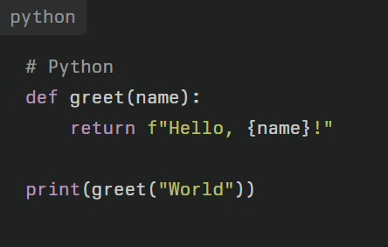
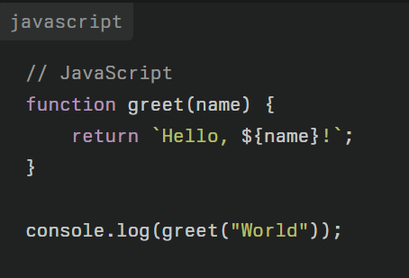
Code Comparison Python and JavaScript
In this small example, we are defining a function “greet” in Python and in JavaScript which takes a parameter called “name” and it will return a string with the name.
In Python, it uses ‘def’ to define a function. Code block are defined by the indentation, while in JavaScript it uses ‘function’ to define a function. It uses curly braces to define the scope.
Python uses f”” for string interpolation, while JavaScript uses ` ` and ${} for embedding expressions

Slide 10
Thanks for listening

Slide 11
References
Krishna, H. (n.d.). Python Vs Javascript: What are the Differences? in 2024. Retrieved September 8, 2024, from https://www.sayonetech.com/blog/python-vs-javascript-what-are-differences/
Navone, E. C. (2021, January 28). Python VS JavaScript – What are the Key Differences Between The Two Popular Programming Languages? freeCodeCamp.Org. https://www.freecodecamp.org/news/python-vs-javascript-what-are-the-key-differences-between-the-two-popular-programming-languages/
Python (programming language). (2024). In Wikipedia. https://en.wikipedia.org/w/index.php?title=Python_(programming_language)&oldid=1244164199
Zen of Python. (2024). In Wikipedia. https://en.wikipedia.org/w/index.php?title=Zen_of_Python&oldid=1228412591

